Slide 1
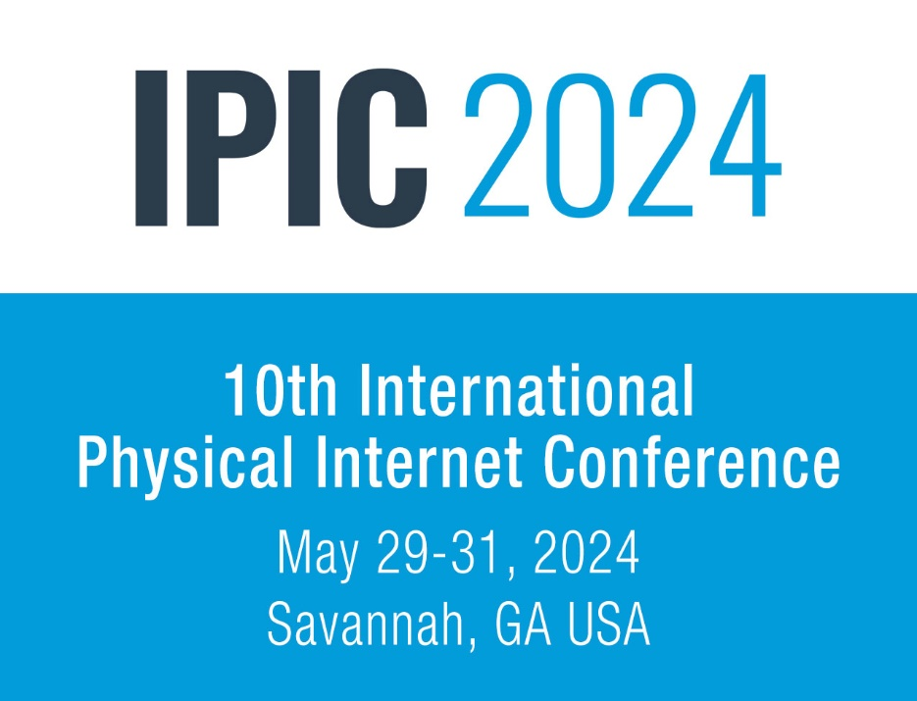
Title of paper for IPIC 2024
Conference
Author 1, Author 2 and Author 3
Affiliation logo(s)
HEADING 1
HEADING 4
Here is an example of a poster which is asked to be used as a template. Please respect the overall dimensions of the Format Din A1 59,4 cm for the width and 84,1 cm for the height (23,38’’x 30,11’’).
The core content may be put into two columns as shown here or may be presented in a single column using the width of the poster.
The poster should summarize the entire research topic. However, it should also capture the interest of participants.
The use of colourful figures and tables efficiently summarizing the paper is strongly encouraged.
Please check if your illustration have a resolution of at least 300 dpi (dots per inch) at the desired image size.
It is important to use vector-based files for graphics containing simple shapes and / or a lot of text (e.g., logos)
HEADING 2
Each section should have a heading. Use Times New Roman, size 66. The 6 blocks shown here are an example. You may use more or less blocks as needed. Examples of headings are:
Introduction
Objectives
Methodology
Results
Implications/Conclusion
Future Work
Acknowledgements
HEADING 5
A pdf file and a pptx file of the poster are to be sent.
Posters will be made available at the authors profile page of the conference and later in ALICE Knowledge Platform. At least one author must ne available in certain times announced by her/him during the assigned time in the event to discuss with other participants.
HEADING 3
Please respect the space provided for title and authors as well as the font (Times New Roman). However, the font size may be reduced for longer titles or numerous authors.
The core content should be written in Times New Roman, at least size 22. Size 24 is easily readable. Font size may vary as needed.
Different coloured text is allowed. However, please choose colours which are easy to read.
HEADING 6
In order to achieve rapid publication, posters will be printed directly from authors’ version. The authors are therefore fully responsible for the quality of their poster, including illustrations. The abstract of the poster will be printed in the proceedings and there will be a link to the PDF of the poster .
Conference Sponsor-Logo Area

